Slide 1
SPAM DETECTION USING MACHINE LEARNING
(FINAL REVIEW)
PRESENTED By :
GOWTHAM RAJ (21AI012)
JAGADEESHWARAN (21AI016)
JASSIM USMAN (21AI017)
Guided By :
Mrs.SENTHAMARAI.M
TEAM NO. 11
17AIC02 – INTRODUCTION TO ARTIFICIAL INTELLIGENCE

Slide 2
Abstract
Email Spam has become a major problem nowadays, with Rapid growth of internet users, Email spams is also increasing.
People are using them for illegal and unethical conducts, phishing and fraud. Sending malicious link through spam emails which can harm our system and can also seek in into your system.
Creating a fake profile and email account is much easy for the spammers, they pretend like a genuine person in their spam emails, these spammers target those peoples who are not aware about these frauds.
So, it is needed to Identify those spam mails which are fraud, this project will identify those spam by using techniques of machine learning, this paper will discuss the machine learning algorithms and apply all these algorithm on our data sets and best algorithm is selected for the email spam detection having best precision and accuracy.
spam mail example: Free entry in 2 a wkly comp to win FA Cup final tkts 21st May 2005. Text FA to 87121 to receive entry question(std txt rate)T&C's apply 08452810075over18's
Ham mail: Hello! How's you and how did saturday go? I was just texting to see if you'd decided to do anything tomo. Not that i'm trying to invite myself or anything

Slide 3
Requirements:
SOFTWARE REQUIREMENTS:
Operating System : Windows XP/ Windows 7/8/8.1/10/11
Front end : HTML&CSS
Back end : Python, CSV, IPYTOHN(Jupyter)
IDE Used : VS Code, Jupyter Notebook
Runing Platform :Any webrowser
HARDWARE CONFIGURATION:
System : HP(Laptop)
Processor : INTEL CORE i3 11th GEN
RAM : 8GB RAM
Hard Disk Capacity : 512 GB

Slide 4
Project Idea:
Spam filtering is a filtering system that implements a set of rules and works with that set of protocols as a classifier.
In the first step, content filters are implemented and use Machine learning techniques to figure out the spam by using the csv file format of excel sheet
Then copy the email or messages and paste it in the website
The Website that we are made with html to test that the message is spam or not spam
In this project we use flask library concepts to to run this project in the website with specific local ip address

Slide 5
Languages used:
HTML - HYPER TEXT MARKUP LANGUAGE(index.html)
CSS - CASCADING STYLE SHEETS(style.css)
PYTHON (NORMAL PYTHON - app .py)
JUPYTER NOTEBOOK PYTHON - Trained Dataset Model.jpynb

Slide 6
Modules:
Dataset training module (created using Jupyter Notebook(ipython)
Web-page designing module(created using HTML and CSS)
Backend(flask) module(created using Python)
Testing module(Testing the whole project)

Slide 7
Module Description:
DATASET TRAINING MODULE :
It is an Backend Module.In this module,First we take the spam message dataset from kaggle.com which is an data science company who have N number of datasets.
After the dataset get downloaded open jupyter notebook and set the project folder directory and create a new ipython file.
In the ipython file first import pandas library to manipulate the dataset. And read the csv file .
After readed the dataset import the sklearn library to train the dataset ,from sklearn use MultinomialNB naive bayes package to classifiers the spam and not spam messages.
After the dataset get trained dump the model into pickle file like(spam_model.pkl)using Joblib library and dump() method.

Slide 8
Module Description:
WEBPAGE DESIGNING MODULE :
It is an Frontend Module . In this module we create an web page using HTML & CSS.
Initially the top heading is created and an text field is to read the message form the user.
After we create an button to run spam detection module.
And we added two different sounds for spam and not spam messages.
In CSS we add style to the each and every part of our webpage for heading, text field, button, images.

Slide 9
Module Description:
BACKEND (FLASK) MODULE:-
Initially imported the flask module to connect the python source to webpage.
After imported the pandas and numpy libraries to analyze and manipulate the dataset. Then import the joblib library to access the trained model .
Next check posted message with dataset and using if-else statements to print the message is spam or not.
After the code get completed save the python code as “app.py”.

Slide 10
Module Description:
TESTING MODULE:
First run the app.py it will generate an IP address.
Then copy the IP address and paste it in any web browser.
After paste the IP address it show the spam detection webpage.
Then paste the message in the text field that you want to check it.
After it check the message with the dataset and report it is spam or not and also play different sounds.
After the spam detection process completed come to app.py shell and press “ctrl+q” Quit the webpage.

Slide 11
MODULES DONE BY EACH MEMBERS
1.DATASET TRAINING MODULE : Done by JAGADEESWARAN VP
2.WEB-PAGE DESIGNING MODULE : Done by JASSIM USMAN.M
3.BACKEND (FLASK) MODULE : Done by GOWTHAM RAJ.B

Slide 12
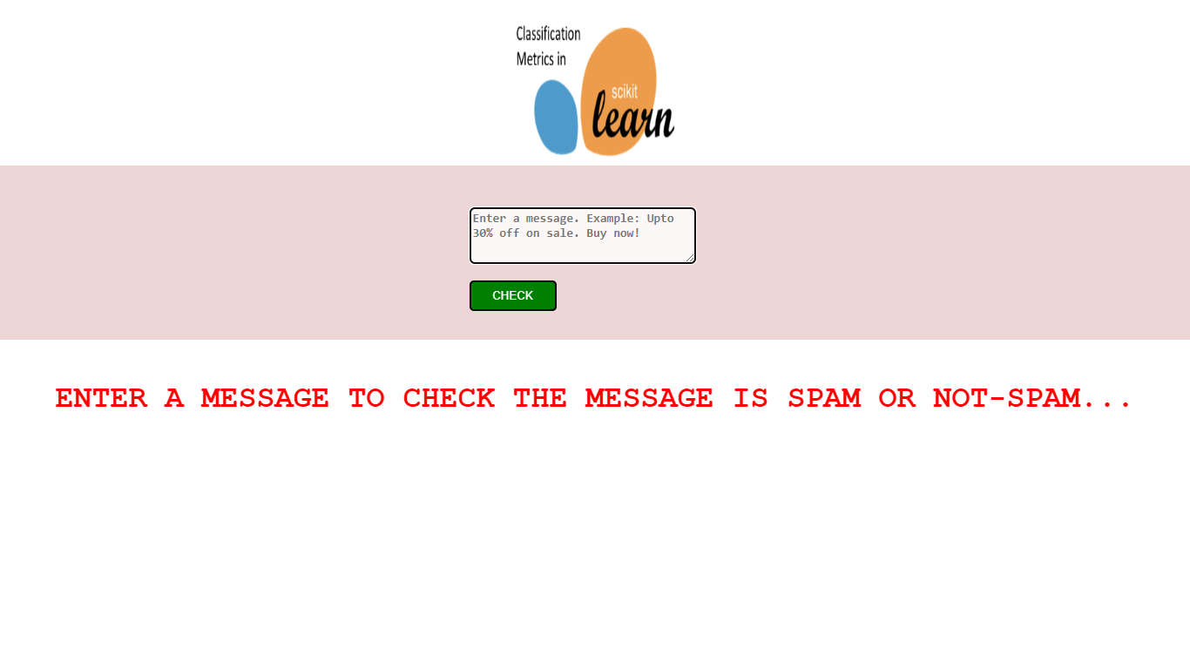
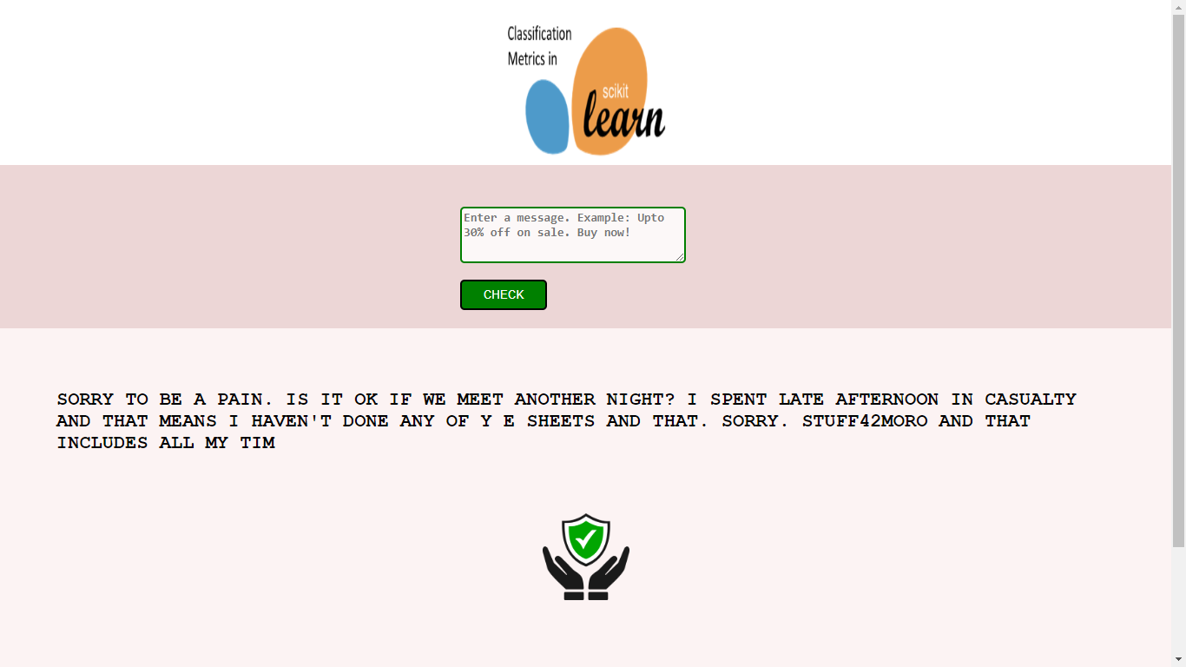
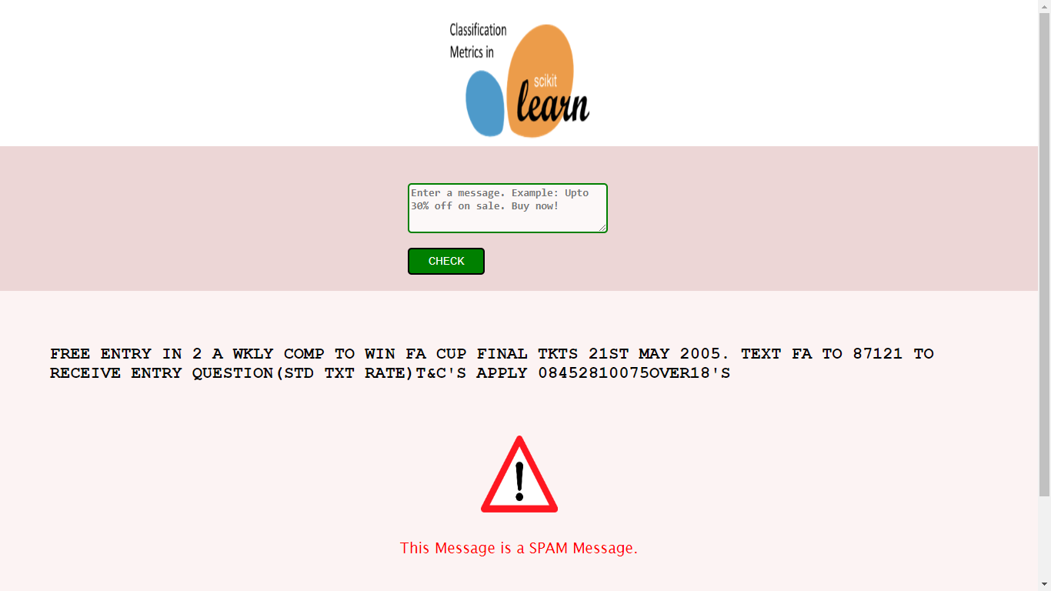
Screen Shots:

Slide 13
Our project detect, unwanted, and virus-infected email and messages(called spam) so our project use to detect this like spam messages and links and the people was aware of this spam Messages in email and form Other Source
Application of the Project:

Slide 14
For Flask: https://www.javatpoint.com/flask-tutorial
For pandas: https://www.javatpoint.com/python-pandas
For Numpy: https://www.w3schools.com/python/numpy/numpy_intro.asp
For Python: https://www.w3schools.com/python/
Book for the above :Python Data Science Handbook: Essential Tools for Working with Data Author: Jacob T. Vanderplas
For Dataset: https://www.kaggle.com/datasets/uciml/sms-spam-collection-dataset
For jupyter notebook : https://www.javatpoint.com/jupyter-notebook
For HTML: https://www.w3schools.com/html / and Book:HTML and CSS: Design and Build Webs Author:Jon Duckett
For CSS: https://www.w3schools.com/css/default.asp
For scikit-learn: https://scikit-learn.org/stable/tutorial/index.html
For Joblib: https://joblib.readthedocs.io/en/latest/
REFERENCE :

Slide 15
Conclusion:
Spam emails and Messages is one of the most demanding and troublesome internet issues in today’s world of communication and technology.
It is almost impossible to think about e-mail and message without considering the issue of spam. Spammers by generating spam mails are misusing this communication facility and thus affecting organisations and many email users.
Our Project have now Used to detect and filter out spam using our website and phishing emails and messages

Slide 16
Future Work:
There are several areas in which the effectiveness of spam detection using machine learning could be improved in the future. Some potential areas of focus include:
Incorporating additional features: Currently, spam detection algorithms often rely on features such as the presence of certain keywords or the structure of the email. However, there may be additional features that could be useful in identifying spam emails, such as the sender's reputation or the presence of unusual formatting.
Developing more advanced machine learning algorithms: There are a variety of machine learning algorithms that could be used for spam detection, including decision trees, support vector machines, and neural networks. Continuing to research and develop more advanced algorithms may lead to more effective spam detection.

Slide 17
CONTD…
Leveraging unstructured data: Many spam emails contain unstructured data, such as images or links, that may not be easily analyzed using traditional machine learning techniques. Developing methods for effectively analyzing and incorporating this type of data into spam detection algorithms could lead to further improvements.
Improving the handling of rare or novel spam techniques: Spammers are constantly evolving their techniques, and it can be challenging for machine learning algorithms to identify new or unusual spam techniques. Developing methods for detecting and adapting to these types of spam could improve the effectiveness of spam detection.

Slide 18

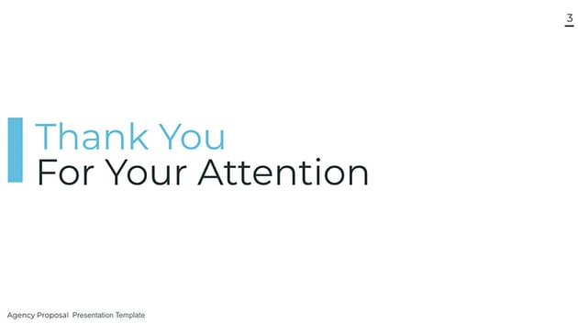
THANK YOU SLIDE :

